Slide 1
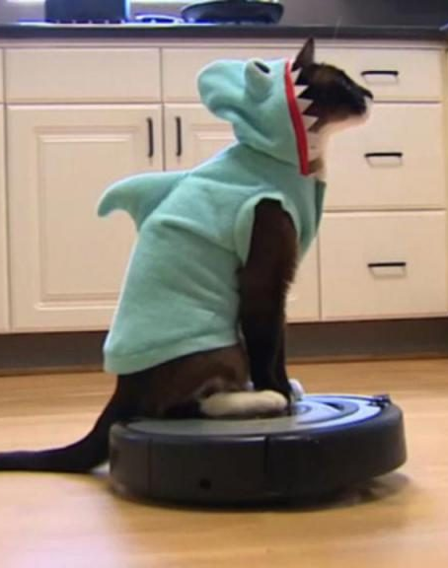
Forward Kinematics!
Meow: This will just be a summary of the key concepts. Please watch lecture slides for more details on the concepts.

Slide 2
Content
What is a DH Matrix?
Robotic Arm model creation using RVC Toolbox
Calculation of forward kinematics using in built function

Slide 3
What is the DH Matrix?
Standardises coordinate frames for spatial linkages.
How do we transform a coordinate frame from one of the robot’s links to another?

Slide 4
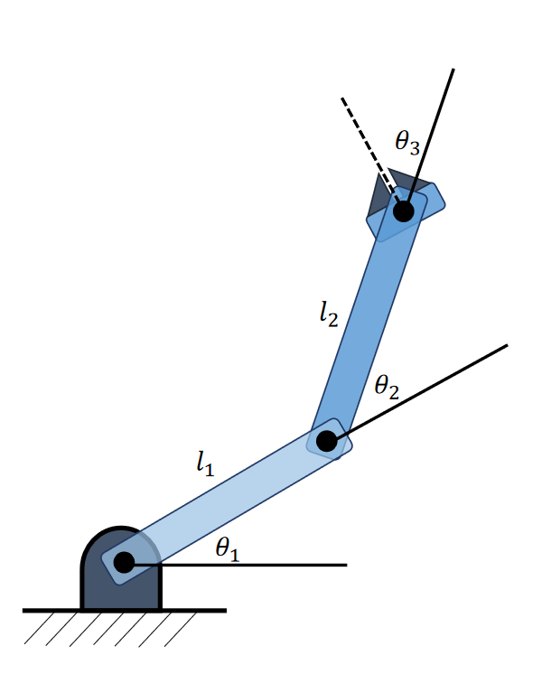
DH Matrix continued.
We know that the base (joint 1) of the robot has a pose with translational component (0,0).
Okay so how do we figure out the pose of the joint 2? What about joint 3?
Is there an easy and standardized mathematical procedure to figure this out?
Joint 3
Joint 2
Joint 1

Slide 5
DH Matrix Continued.
The DH Matrix represents 4 physical parameters of each joint which we then use to figure out how a coordinate frame transforms as it moves from one link to another.
The 4 physical parameters are:
Angle : ϴ
Offset : d
Length: a
Twist : α

Slide 6
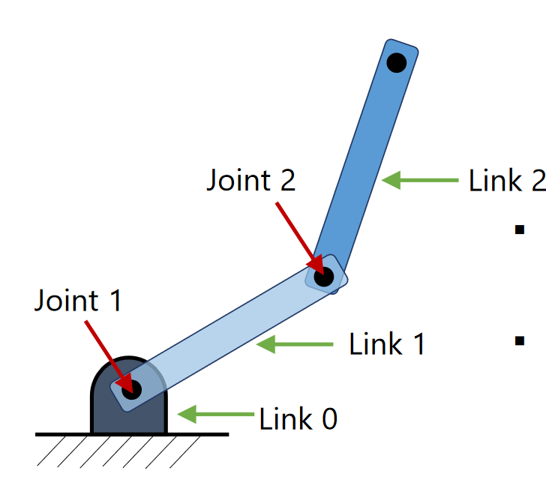
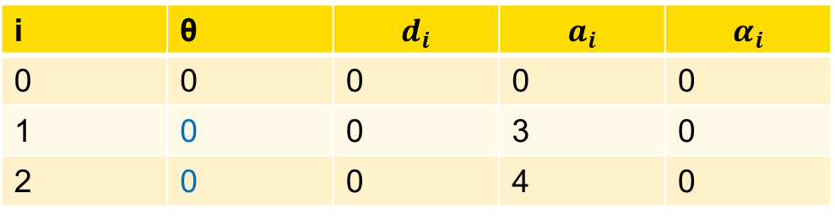
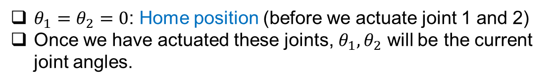
RVC Toolbox Example.
4
i | θ | $$d_{i}$$ | $$a_{i}$$ | $$α_{i}$$
0 | 0 | 0 | 0 | 0
1 | 0 | 0 | 3 | 0
2 | 0 | 0 | 4 | 0
3
$θ_{1}=θ_{2}=0$: Home position (before we actuate joint 1 and 2)
Once we have actuated these joints, $θ_{1}, θ_{2}$ will be the current joint angles.

Slide 7
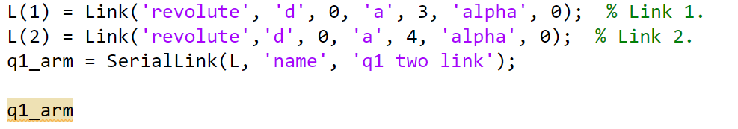
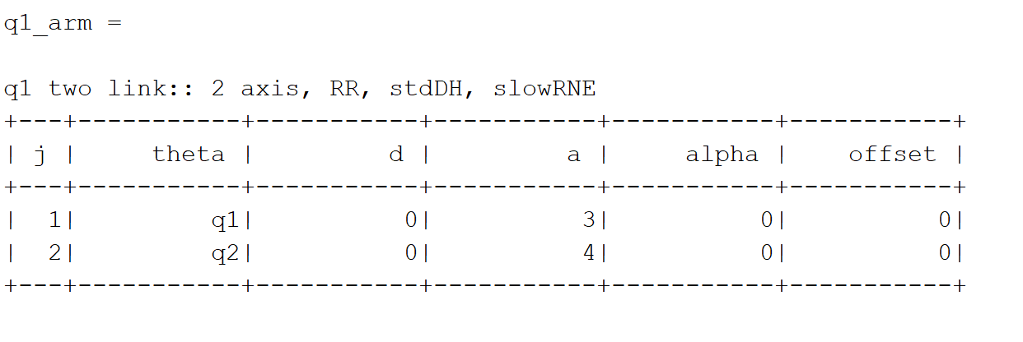
RVC Toolbox Example
Method 1:

Slide 8
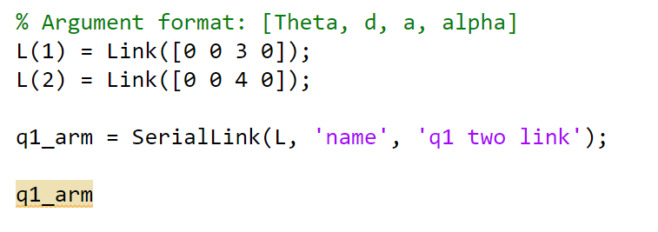
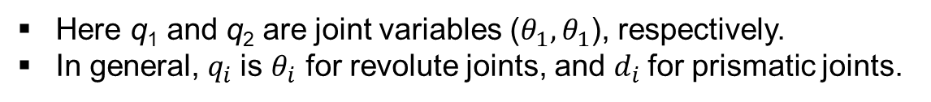
RVC Toolbox Example
Method 2:
Note: Slightly different input format, but same output
Here q₁ and q₂ are joint variables ($θ_{1}, θ_{1}$), respectively.
In general, $q_{i}$is $θ_{i}$ for revolute joints, and $d_{i}$for prismatic joints.

Slide 9
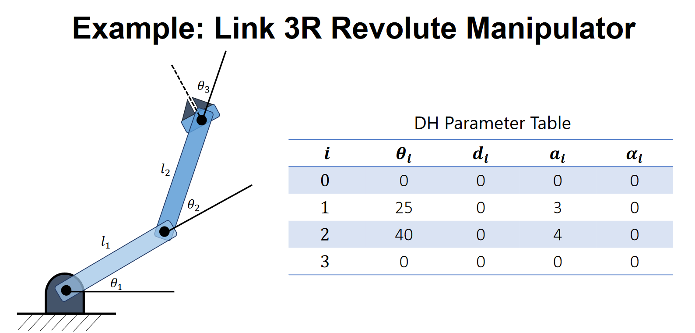
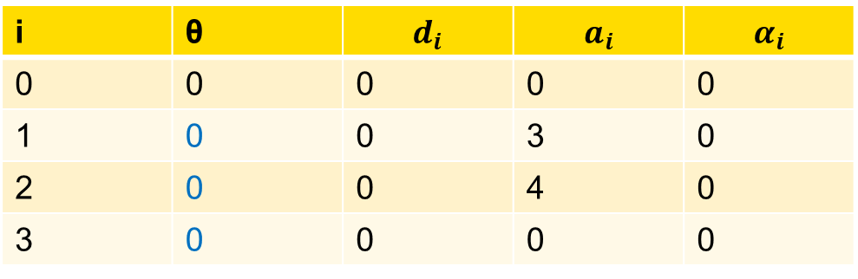
RVC Toolbox Example: What if we want to add an end effector?
i | θ | $$d_{i}$$ | $$a_{i}$$ | $$α_{i}$$
0 | 0 | 0 | 0 | 0
1 | 0 | 0 | 3 | 0
2 | 0 | 0 | 4 | 0
3 | 0 | 0 | 0 | 0
$θ_{1}=θ_{2}=θ_{3}= 0$: Home position (before we actuate joint 1 and 2)
https://www.petercorke.com/RTB/r9/html/SerialLink.html

Slide 10
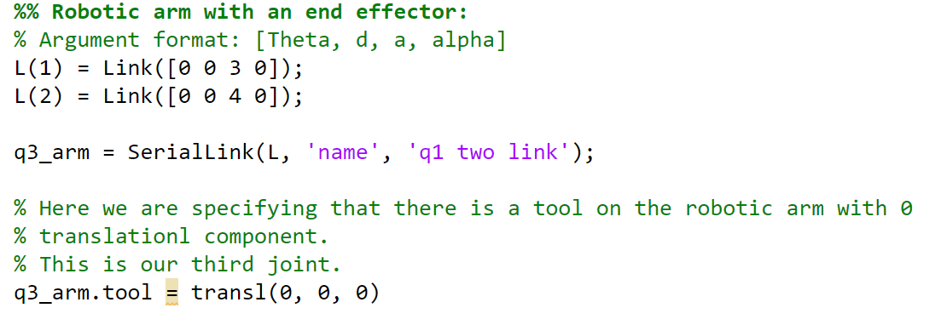
RVC Toolbox Example: What if we want to add an end effector?

Slide 11
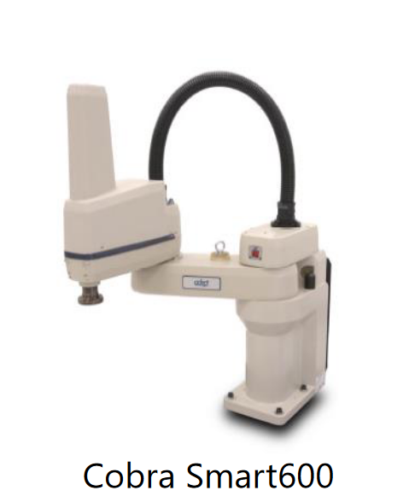
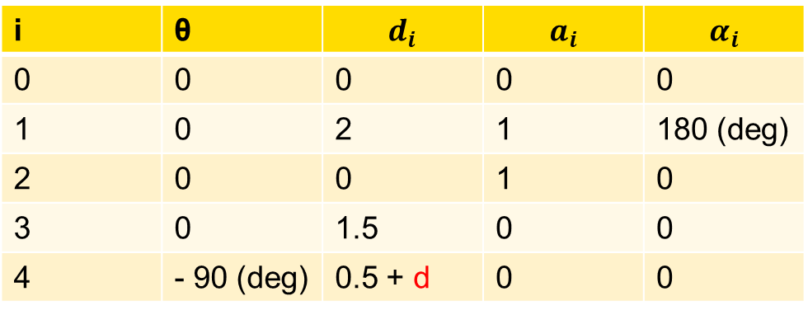
RVC Toolbox Example: What about a SCARA Robot?
Is this an RRR Robot or an RRP robot?
i | θ | $$d_{i}$$ | $$a_{i}$$ | $$α_{i}$$
0 | 0 | 0 | 0 | 0
1 | 0 | 2 | 1 | 180 (deg)
2 | 0 | 0 | 1 | 0
3 | 0 | 0.5 + d | 0 | 0
What does the ‘d’ represent?

Slide 12

RVC Toolbox Example: What about a SCARA Robot?
Is this an RRR Robot or an RRP robot? RRP!
i | θ | $$d_{i}$$ | $$a_{i}$$ | $$α_{i}$$
0 | 0 | 0 | 0 | 0
1 | 0 | 2 | 1 | 180 (deg)
2 | 0 | 0 | 1 | 0
3 | 0 | 0.5 + d | 0 | 0
What does the ‘d’ represent? : The extension of the prismatic joint!

Slide 13
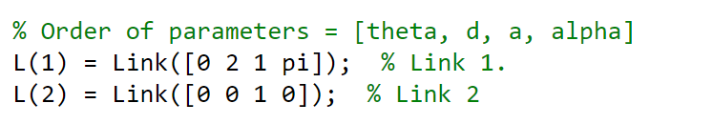
RVC Toolbox Example: What about a SCARA Robot?
The first two links are as normal. They are both revolute.

Slide 14
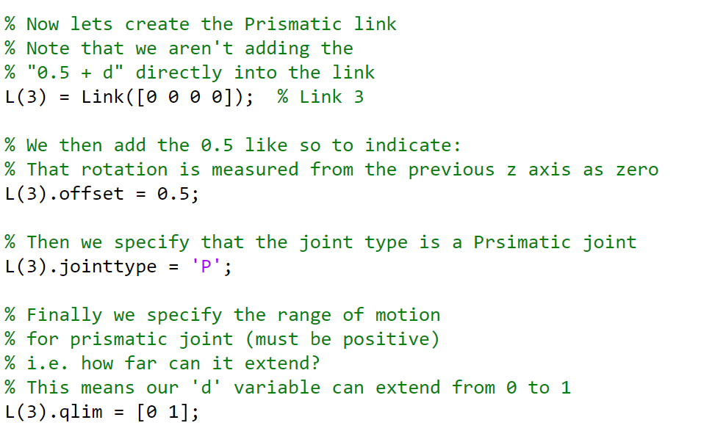
RVC Toolbox Example: What about a SCARA Robot?
The construction of the last one. The prismatic link is slightly different.

Slide 15
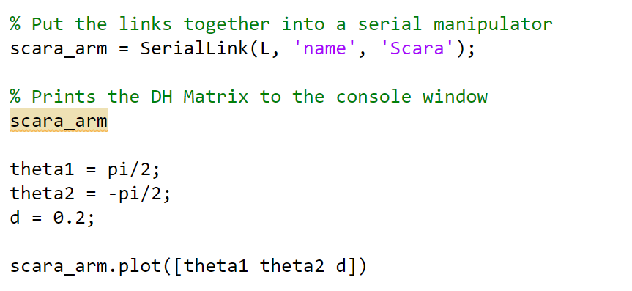
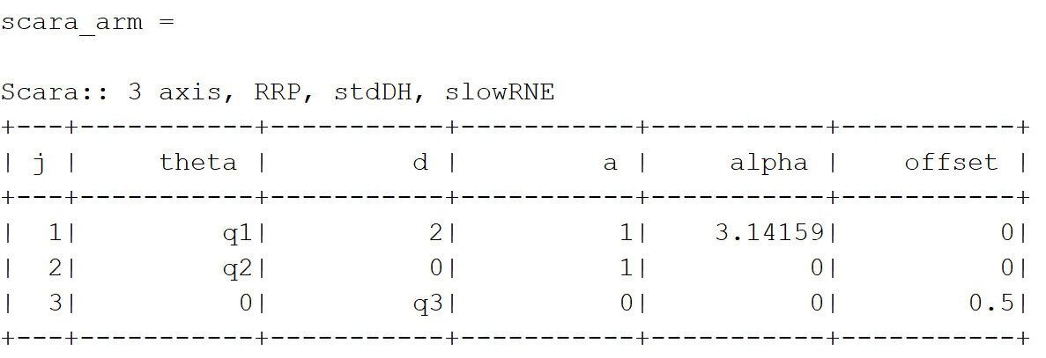
RVC Toolbox Example: What about a SCARA Robot?
The q3 here represents the ‘d’ in our original DH Matrix. And the 0.5 is the original 0.5 from the DH Matrix. It’s just the format of the display here which is different.

Slide 16
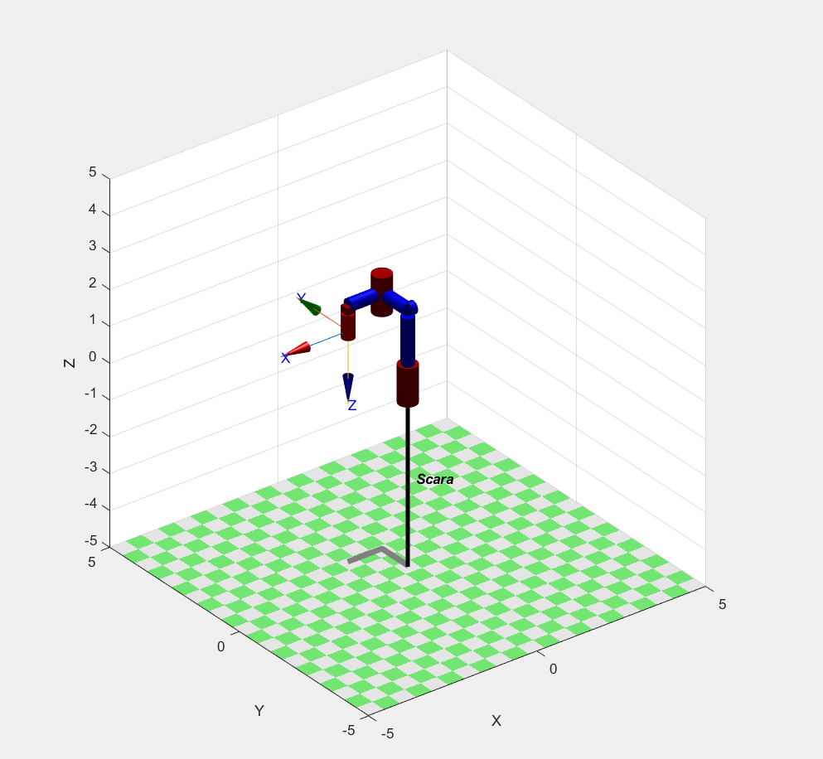
RVC Toolbox Example: What about a SCARA Robot?
And plot!

Slide 17
Calculating Forward Kinematics!
Going from having joint positions to a final pose!
Once you have created a model, you can now specify joint configurations and then calculate the forward kinematic solution
But lets do some manual calculations first!

Slide 18
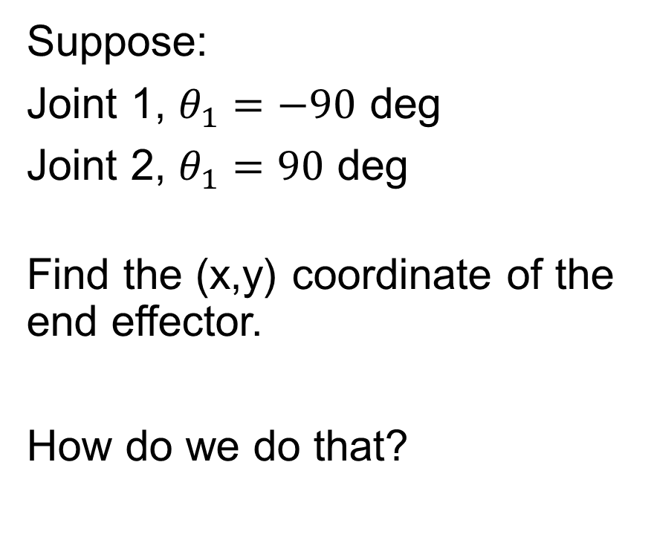
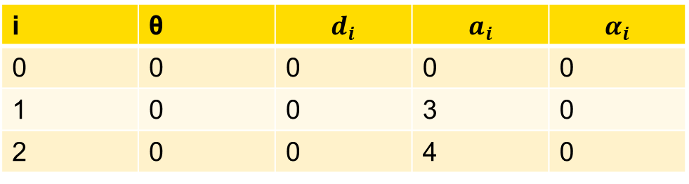
Forward Kinematics Manual Calculation:
Suppose:
Joint 1, $θ_{1}=−90$ deg
Joint 2, $θ_{1}=90$ deg
Find the (x,y) coordinate of the end effector.
How do we do that?
i | θ | $$d_{i}$$ | $$a_{i}$$ | $$α_{i}$$
0 | 0 | 0 | 0 | 0
1 | 0 | 0 | 3 | 0
2 | 0 | 0 | 4 | 0

Slide 19
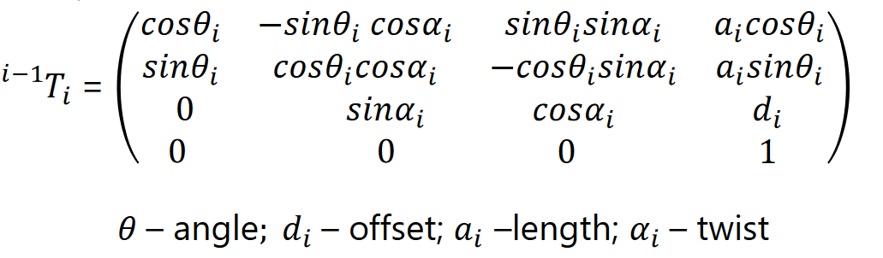
Forward Kinematics Manual Calculation Continued.
Using the Frame Transformation matrix!

Slide 20
Forward Kinematics Manual Calculation Continued.
We pass in the value from the DH convention (angle, offset, length and twist) of each specific joint, to calculate a frame which represents the transformation from the previous joint?
What does this mean?

Slide 21
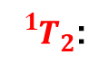
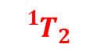
Forward Kinematics Manual Calculation Continued.
${{}_{}^{1}T}_{2}$:
Basically, what is the transformation matrix at joint 2 from the frame of reference (aka transformation) of joint 1
$${{}_{}^{1}T}_{2}$$

Slide 22
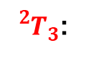
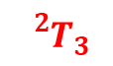
Forward Kinematics Manual Calculation Continued.
$${{}_{}^{2}T}_{3}$$
${{}_{}^{2}T}_{3}$:
What is the transformation matrix at joint 3 from the frame of reference (aka transformation) of joint 2

Slide 23
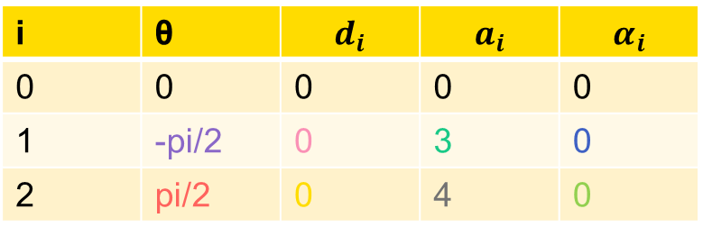
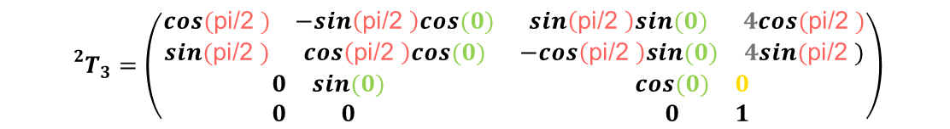
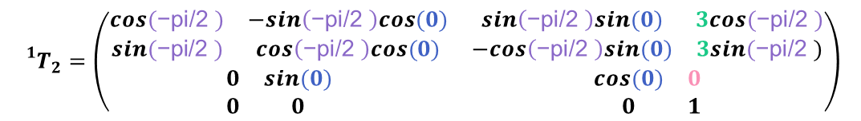
Forward Kinematics Manual Calculation! Now lets do it!
We know, the DH Matrix
And, the know the frame transformation matrix!
$${{}_{}^{1}T}_{2}=\left(\begin{matrix}\begin{matrix}cos(\text{−}\text{pi}\text{/2 }) & −sin\left(\text{−}\text{pi}\text{/2 }\right)cos(0) \\ sin(\text{−}\text{pi}\text{/2 }) & cos\left(\text{−}\text{pi}\text{/2 }\right)cos(0)\end{matrix} & \begin{matrix}sin\left(\text{−}\text{pi}\text{/2 }\right)sin(0) & 3cos(\text{−}\text{pi}\text{/2 }) \\ −cos\left(\text{−}\text{pi}\text{/2 }\right)sin(0) & 3sin(\text{−}\text{pi}\text{/2 })\end{matrix} \\ \begin{matrix}0 & sin(0) \\ 0 & 0\end{matrix} & \begin{matrix}cos(0) & 0 \\ 0 & 1\end{matrix}\end{matrix}\right)$$
i | θ | $$d_{i}$$ | $$a_{i}$$ | $$α_{i}$$
0 | 0 | 0 | 0 | 0
1 | -pi/2 | 0 | 3 | 0
2 | pi/2 | 0 | 4 | 0
$${{}_{}^{2}T}_{3}=\left(\begin{matrix}\begin{matrix}cos(\text{pi}\text{/2 }) & −sin\left(\text{pi}\text{/2 }\right)cos(0) \\ sin(\text{pi}\text{/2 }) & cos\left(\text{pi}\text{/2 }\right)cos(0)\end{matrix} & \begin{matrix}sin\left(\text{pi}\text{/2 }\right)sin(0) & 4cos(\text{pi}\text{/2 }) \\ −cos\left(\text{pi}\text{/2 }\right)sin(0) & 4sin(\text{pi}\text{/2 })\end{matrix} \\ \begin{matrix}0 & sin(0) \\ 0 & 0\end{matrix} & \begin{matrix}cos(0) & 0 \\ 0 & 1\end{matrix}\end{matrix}\right)$$

Slide 24

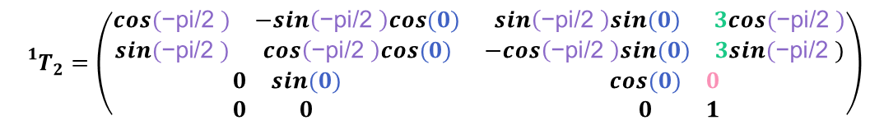
Forward Kinematics Manual Calculation! Now lets do it!
0 1 0 0
-1 0 0 -3
0 0 1 0
0 0 0 1
$${{}_{}^{1}T}_{2}=\left(\begin{matrix}\begin{matrix}cos(\text{−}\text{pi}\text{/2 }) & −sin\left(\text{−}\text{pi}\text{/2 }\right)cos(0) \\ sin(\text{−}\text{pi}\text{/2 }) & cos\left(\text{−}\text{pi}\text{/2 }\right)cos(0)\end{matrix} & \begin{matrix}sin\left(\text{−}\text{pi}\text{/2 }\right)sin(0) & 3cos(\text{−}\text{pi}\text{/2 }) \\ −cos\left(\text{−}\text{pi}\text{/2 }\right)sin(0) & 3sin(\text{−}\text{pi}\text{/2 })\end{matrix} \\ \begin{matrix}0 & sin(0) \\ 0 & 0\end{matrix} & \begin{matrix}cos(0) & 0 \\ 0 & 1\end{matrix}\end{matrix}\right)$$
0 -1 0 0
1 0 0 4
0 0 1 0
0 0 0 1
$${{}_{}^{2}T}_{3}=\left(\begin{matrix}\begin{matrix}cos(\text{pi}\text{/2 }) & −sin\left(\text{pi}\text{/2 }\right)cos(0) \\ sin(\text{pi}\text{/2 }) & cos\left(\text{pi}\text{/2 }\right)cos(0)\end{matrix} & \begin{matrix}sin\left(\text{pi}\text{/2 }\right)sin(0) & 4cos(\text{pi}\text{/2 }) \\ −cos\left(\text{pi}\text{/2 }\right)sin(0) & 4sin(\text{pi}\text{/2 })\end{matrix} \\ \begin{matrix}0 & sin(0) \\ 0 & 0\end{matrix} & \begin{matrix}cos(0) & 0 \\ 0 & 1\end{matrix}\end{matrix}\right)$$

Slide 25

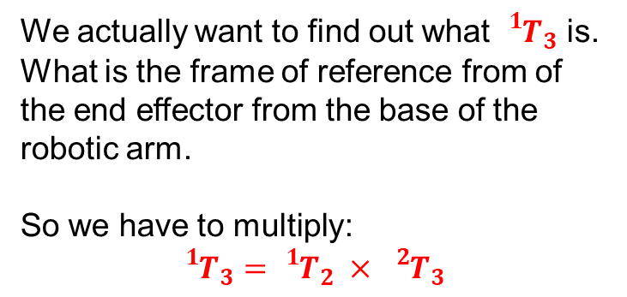
But is that actually our final solution? Well…not really.
$${{}_{}^{0}T}_{2}$$
We actually want to find out what ${{}_{}^{1}T}_{3}$ is. What is the frame of reference from of the end effector from the base of the robotic arm.
So we have to multiply:
$${{}_{}^{1}T}_{3}={{}_{}^{1}T}_{2} × {{}_{}^{2}T}_{3}$$

Slide 26
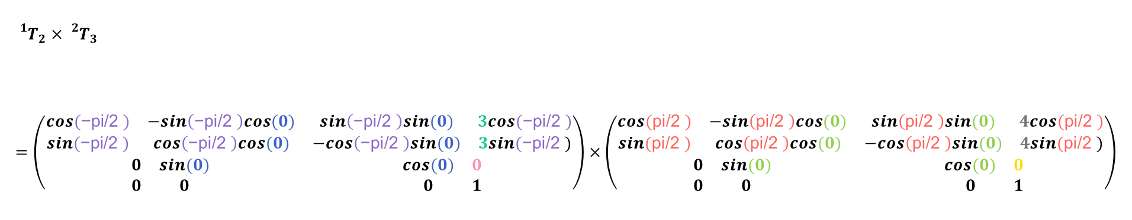
Forward Kinematics Manual Calculation! Now lets do it!
$${{}_{}^{1}T}_{2}×{{}_{}^{2}T}_{3} \\ =\left(\begin{matrix}\begin{matrix}cos(\text{−}\text{pi}\text{/2 }) & −sin\left(\text{−}\text{pi}\text{/2 }\right)cos(0) \\ sin(\text{−}\text{pi}\text{/2 }) & cos\left(\text{−}\text{pi}\text{/2 }\right)cos(0)\end{matrix} & \begin{matrix}sin\left(\text{−}\text{pi}\text{/2 }\right)sin(0) & 3cos(\text{−}\text{pi}\text{/2 }) \\ −cos\left(\text{−}\text{pi}\text{/2 }\right)sin(0) & 3sin(\text{−}\text{pi}\text{/2 })\end{matrix} \\ \begin{matrix}0 & sin(0) \\ 0 & 0\end{matrix} & \begin{matrix}cos(0) & 0 \\ 0 & 1\end{matrix}\end{matrix}\right)×\left(\begin{matrix}\begin{matrix}cos(\text{pi}\text{/2 }) & −sin\left(\text{pi}\text{/2 }\right)cos(0) \\ sin(\text{pi}\text{/2 }) & cos\left(\text{pi}\text{/2 }\right)cos(0)\end{matrix} & \begin{matrix}sin\left(\text{pi}\text{/2 }\right)sin(0) & 4cos(\text{pi}\text{/2 }) \\ −cos\left(\text{pi}\text{/2 }\right)sin(0) & 4sin(\text{pi}\text{/2 })\end{matrix} \\ \begin{matrix}0 & sin(0) \\ 0 & 0\end{matrix} & \begin{matrix}cos(0) & 0 \\ 0 & 1\end{matrix}\end{matrix}\right)$$
0 1 0 0
-1 0 0 -3
0 0 1 0
0 0 0 1
0 -1 0 0
1 0 0 4
0 0 1 0
0 0 0 1
1 0 0 4
0 1 0 -3
0 0 1 0
0 0 0 1
x
=

Slide 27
Calculating Forward Kinematics!
For our 2 link robot, we know that it has two joints
What if our joint position was [-pi/2, pi/2], how do we calculate the pose at?

Slide 28
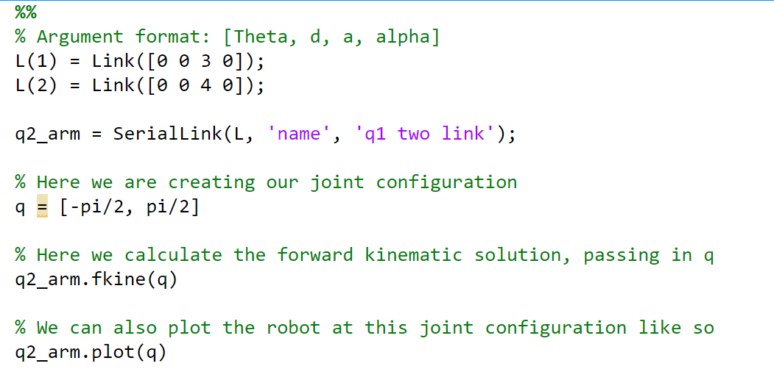
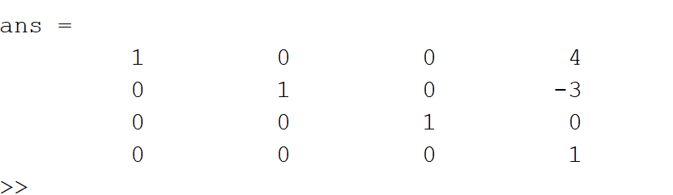
Calculating Forward Kinematics!
Matches up with our manual calculation!

Slide 29
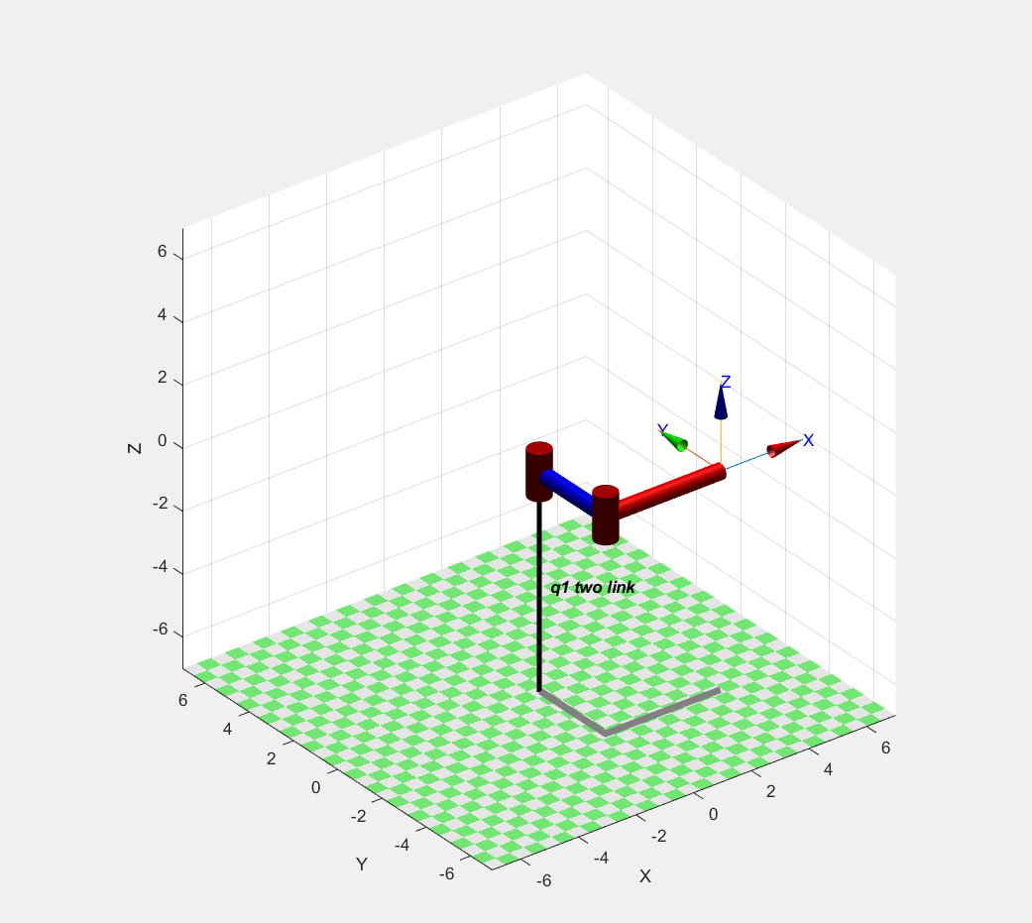
Calculating Forward Kinematics! The plot!

Slide 30
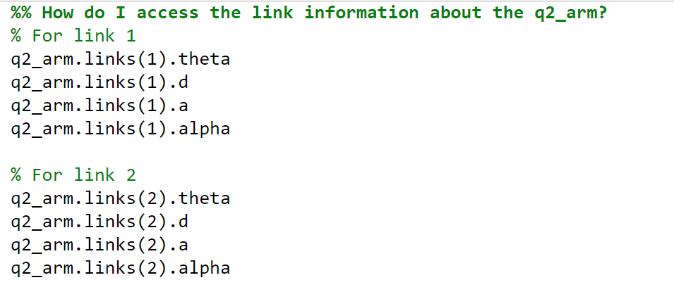
Accessing the angle, offset, length and twist information from the model

